Slide 1

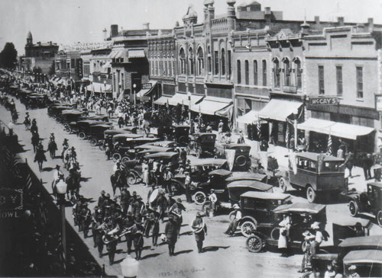
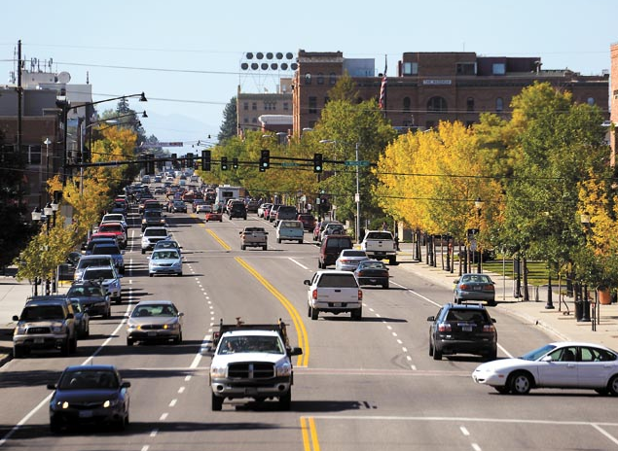
Downtown Bozeman, MT
Comprehensive Downtown Parking Plan
June 2016

Slide 2
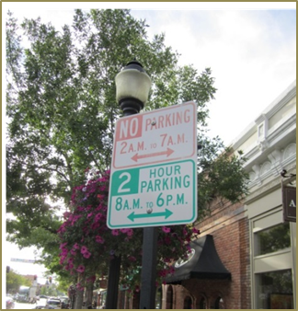
Agenda
Overview of Study Area
Outreach to date
3. Why Parking Management in Bozeman
4. Key Findings
5. Phased Parking Plan
6. Strategies (0 – 18 months)
7. Strategies (18 – 36 months)
8. Q&A

Slide 3
Study Area Boundary

Slide 4
Outreach and Discussion (to date)
Dec. 26, 2015: Downtown Partnership Postcard mailing re: January Meetings
150+ downtown property owners within Business Improvement District
Dec. 31, 2015: Downtown Partnership e-Announcement re: January Meetings
(408 sent--158 opened) (44%)
Jan. 13, 2016: Neighborhood Public Meeting
Jan. 14, 2016: Bozeman Parking Commission
Jan. 14, 2016: Stakeholder Public Meeting
March 10, 2016: Bozeman Parking Commission
"Review of Guiding Principles Discussion and Parking Plan Update"

Slide 5
Outreach and Discussion (to date)
May 12, 2016: Bozeman Parking Commission
"Review of Draft Downtown Strategic Parking Management Plan"
May 31, 2016: Downtown Partnership e-Announcement re: June Meetings
1071 sent--316 opened (33%)--39 click-throughs to draft report
This Week
June 8 Neighborhood Public Meeting
June 9 Bozeman Parking Commission
June 9 Stakeholder Public Meeting

Slide 6
The Role of Parking Management
Support a vital, growing and interesting downtown.
Get the right parker to the right stall (customers, employees, residents).
Ensure convenient, affordable, and readily available parking.
Ensure that the needs of priority users are met.
Ensure safe parking for all users.
Minimize spillover into abutting neighborhoods.
Ensure that the parking system is financially sustainable and accommodates future growth.

Slide 7
Intended Outcomes (Bozeman Plan)
A financially sustainable parking system.
A quality parking system (programs and infrastructure).
Sound decision-making supported by objective data and best practices.
Using existing resources to their highest potential.
Planning for growth successfully.

Slide 8
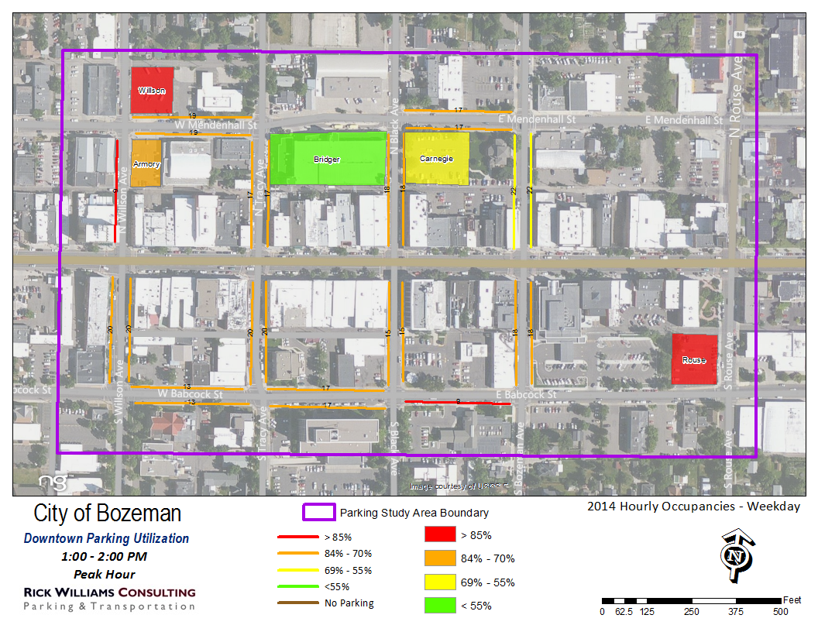
Key Findings
System lacks formal policy direction for strategic and timely decision-making.
Initial data indicates on-street parking is heavily utilized peak season (>85%).
Off-street parking presents an opportunity for absorbing demand.
Little is known about the private supply of parking.
More data needed during non-peak periods.

Slide 9
Key Findings
Existing equipment systems are outdated (i.e., Bridger Garage).
The parking system is not financially sustainable, particularly as regards future growth of supply.
Status quo system(s) will not result in desired solutions.
Tasks associated with implementing a new parking management plan will require a level of time, resources, reporting/data collection and public engagement that are not currently in place.
Resource identification will be critical to plan implementation.

Slide 10
Phased Parking Plan
The parking plan is iterative and divided into two phases.
PHASE 1: 0 – 18 months
PHASE 2: 18 – 36+ months

Slide 11
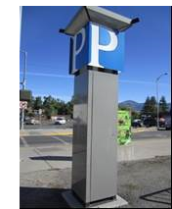
Phase 1
PHASE 1: 0 – 18 months
Strategies 1 – 17 set the stage for:
solving near term problems,
implementing basic improvements to the system,
gathering data to inform good long-term decision making,
maximizing existing supply, and
Setting the stage for new programs and infrastructure.

Slide 12
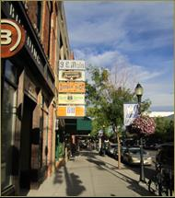

Strategy Recommendations (Phase 1)
POLICY & ORGANIZATION
Formalize Guiding Principles and 85% Rule
Strengthen the role of the Parking Manager and the Parking Services division to better integrate with Community and Economic development planning.
Establish a policy for adjusting rates (on and off-street).
Establish a Capital Maintenance Reserve Fund.

Slide 13
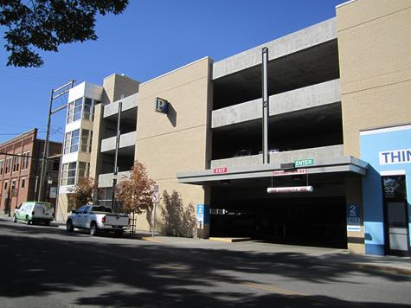
Strategy Recommendations (Phase 1)
CODE RELATED
Re-evaluate and restructure the current “cash-in-lieu” program (38.25.040 A. 3. B 1 -4, BMC).
Re-evaluate code-based minimum parking requirements (See 38.25.040 A.2. a & b, BMC).

Slide 14
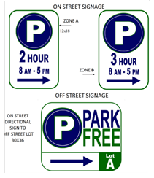
Strategy Recommendations (Phase 1)
PARKING MANAGEMENT/OPERATIONS
Enhance facilities maintenance plan & upgrade Bridger Garage.
Develop a schedule of data collection, including on- and off-street inventory (public and private supply).
Identify and negotiate off-street shared-use opportunities.
Simplify on-street time stays, consider use of current City parking logo in on-street signage.
Example (Springfield, OR): Incorporating Parking Logo into on-street signage.

Slide 15
Strategy Recommendations (Phase 1)
PARKING MANAGEMENT/OPERATIONS
Establish best-practice protocols for existing enforcement personnel and support enforcement with appropriate technology.
Expand bike parking network to create connections between parking and the downtown to encourage employee bike commute trips and draw customers to downtown businesses.
Evaluate and pursue on-street pricing in high-occupancy areas (based on data and cost feasibility).

Slide 16
Phase 2
18 – 36+ months
Strategies 18 – 24 set the stage for:
pricing parking,
creating new access capacity
coordinated parking management in neighborhoods
Identifying funding options for new capacity/growth
Sustained management and service delivery

Slide 17
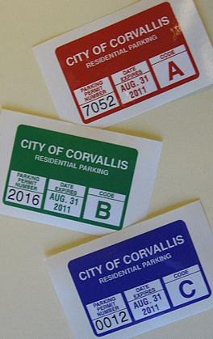
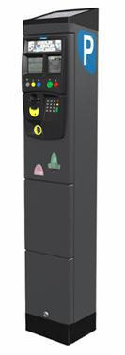
Strategy Recommendations (Phase 2)
MANAGING GROWTH
Transition to on-street pricing (based on Phase 1 findings):
Explore residential and employee permit programs (on-street)
Initiate rigorous public engagement and communications/rollout strategy
Implement on-street pricing
Complete the 2008 Parking District identification Signage/Branding Plan.

Slide 18
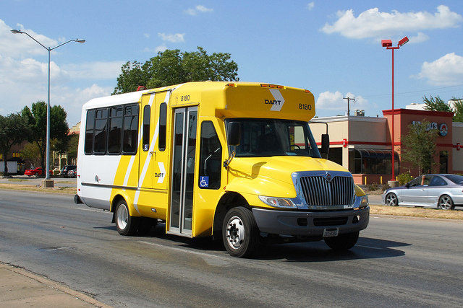
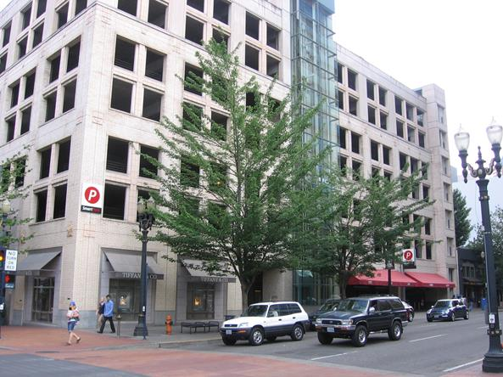
Strategy Recommendations (Phase 2)
MANAGING GROWTH
Explore expanding access capacity – new parking supply and/or transit/shuttle options
Identify parking sites
Identify transit/shuttle routes and frequencies
Cost forecasting
Develop funding options
Initiate new capacity plan (est. June 2020)

Slide 19
Q & A
Thoughts, Ideas, and Questions

Slide 20
THANK YOU!

